Slide 1
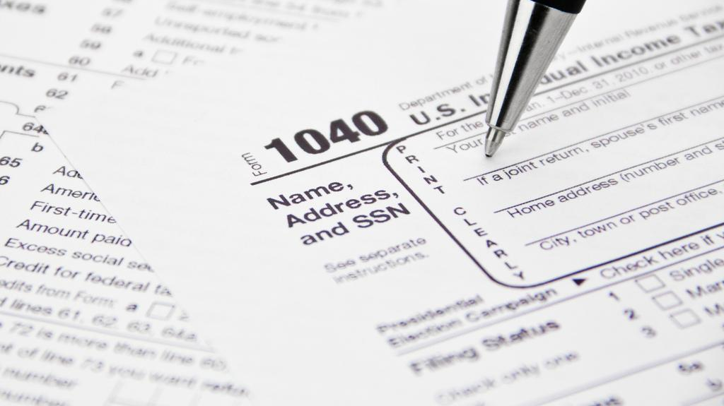
Forms in PHP
Michal Špaček, www.michalspacek.com, @spazef0rze
https://www.flickr.com/photos/teegardin/5512347305

Slide 2
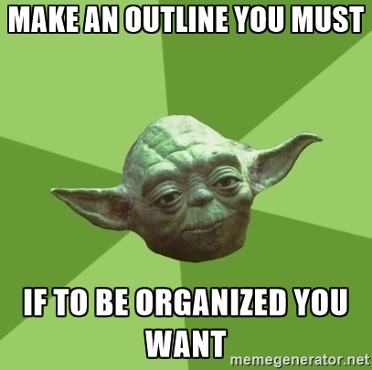

Slide 3
Recap
New stuff

Slide 4
Recap
Variables , arrays
New stuff
Forms

Slide 5
Recap
Variables , arrays
New stuff
Forms
Input fields
Data validation
GET and POST methods
Data processing

Slide 6


Slide 7

RECAP Variables and types
Hi
1
$var1
$number
T
abcd
$statement
$name

Slide 8
RECAP Operators
operand operator operand
$var = 1 + 1;
2
$var

Slide 9
RECAP Comparison
$var == 123;
if ($var == 123) { echo 'sure thing'; } else { echo 'nope'; }

Slide 10
RECAP Arrays
A collection of elements, each identified by at least one array index or key.
$odd = array(1, 3, 5, 7);
$odd = [1, 3, 5, 7];
echo $odd[2];
Keys: Values:
0 | 1 | 2 | 3
1 | 3 | 5 | 7

Slide 11
RECAP Associative arrays, keys are strings
$user = array( 'firstname' => 'John', 'lastname' => 'Foo', 'email' => 'foo@bar.net', 'country' => 'US' );
echo $user['firstname'];
Keys: Values:
firstname | lastname | email | country
John | Foo | foo@bar .net | US

Slide 12
RECAP Loops iterate, also through arrays
for ($i = 0; $i < 10; $i++) { echo $i; }
foreach ($user as $key => $value) { echo "$key $value"; }
foreach ($user as $value) { echo $value; }

Slide 13
NEW STUFF! Forms, user input
<form action="script.php" method="get"> HTML + form fields </form>

Slide 14
Basic form fields
Text <input type="text" name="firstname" value="prefilled">
Checkbox <input type="checkbox" name="hungry" checked>
Radiobutton <input type="radio" name="country" value="US"> <input type="radio" name="country" value="CZ" checked>

Slide 15
Basic form fields – selectbox
<select name="country"> <option value="US">US</option> <option value="CZ" selected>CZ</option> <option value="SK">SK</option> </select>

Slide 16
Basic form fields – textarea, buttons
Textarea <textarea name="address">prefilled</textarea>
Buttons <input type="submit" value="Submit"> <button><strong>Sub<em>mit</em></strong></button>

Slide 17
Form accessibility
Placeholders <input type="text" name="firstname" placeholder="text"> Tabindex <input type="text" name="firstname" tabindex="2"> <input type="text" name="firstname" tabindex="1"> <input type="text" name="firstname" tabindex="3">
Labels <label for="send">send?</label> <input type="checkbox" name="send" id="send">

Slide 18
HTTP methods
Methods of user input delivery
<form action="script.php" method="get">
get https://example.com/script.php?firstname=John&lastname=Foo
post https://example.com/script.php + data in the request body

Slide 19
Form data in PHP
Method get https://example.com/script.php?firstname=John&lastname=Foo echo htmlspecialchars($_GET['firstname']); echo htmlspecialchars($_GET['lastname']);
Method post https://example.com/script.php + data in the request body echo htmlspecialchars($_POST['firstname']); echo htmlspecialchars($_POST['lastname']);

Slide 20
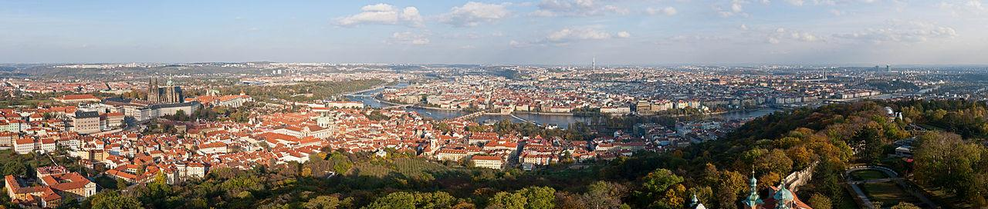
PRG Post-Redirect-Get
https://en.wikipedia.org/wiki/File:Prague_Panorama_-_Oct_2010.jpg

Slide 21
To avoid form re-submit
if (form_validated_ok()) {
save_data();
header('Location: index.php');
exit();
}

Slide 22
Data validation
if (!isset($_POST['email'])) { echo 'email missing'; }
if (empty($_POST['email'])) { echo 'email empty'; }

Slide 23
Data validation
Check email address if (!filter_var($_GET['email'], FILTER_VALIDATE_EMAIL)) { echo 'wrong email'; }
Only numbers allowed if (!ctype_digit($_GET['amount'])) { echo 'not a number'; }

Slide 24
File uploads
HTML <form enctype="multipart/form-data" action="..." method="post"> <input name="afile" type="file"> <input type="submit" value="Send"> </form>
PHP code $_FILES['afile']['name'] $_FILES['afile']['tmp_name']
move_uploaded_file($_FILES['afile']['tmp_name'], $destination)

